Slide 1

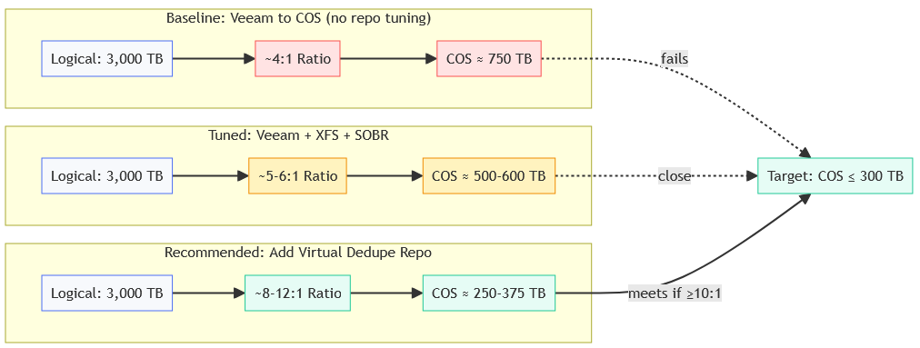
Acceptance: COS ≤ 300 TB at day 36; target ≥10:1 (expected 8–12:1)
Notes:
Purpose and Context
Goal: keep IBM COS at or below 300 TB for 36-day retention.
Baseline (Veeam → COS only): ~4:1, ≈750 TB — fails.
Tuned (Veeam + XFS + SOBR): ~5–6:1, ≈500–600 TB — still over.
Recommended (add virtual dedupe repo): ~8–12:1, ≈250–375 TB — meets target at ≥10:1.
Message: one added software component achieves the requirement.

Slide 2
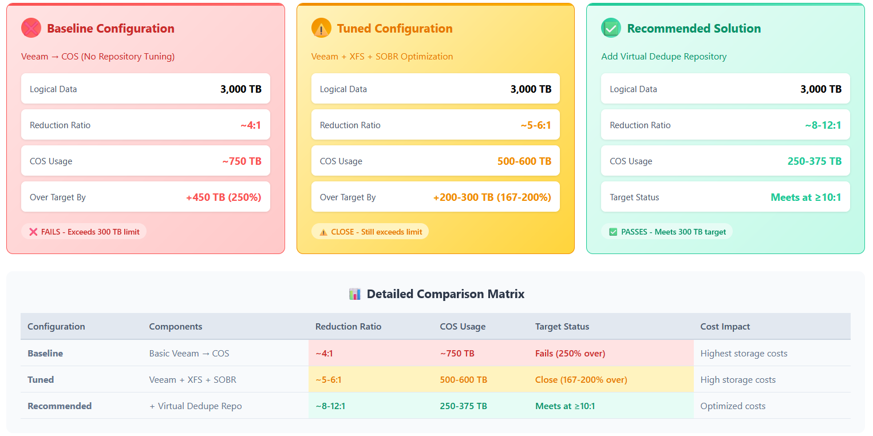
Acceptance: COS ≤ 300 TB at day 36; target ≥10:1 (expected 8–12:1)
Notes:
What this proves
Quantifies three options against COS ≤ 300 TB (36 days).
Baseline: ~4:1 → ~750 TB (250% over) — fails.
Tuned (XFS + SOBR): ~5–6:1 → 500–600 TB (167–200% over) — still fails.
Recommended (add virtual dedupe repo): ~8–12:1 → 250–375 TB — meets at ≥10:1.
Cost: baseline = highest; tuned = high; recommended = optimized.
Decision: proceed with the software-only virtual dedupe repo to hit the target.

Slide 3
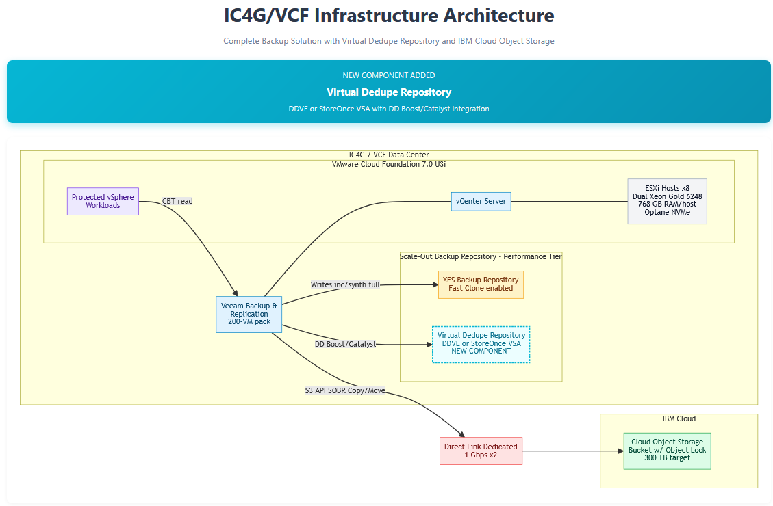

Software-only VM (DDVE or StoreOnce VSA)—no new hardware.
Notes:
Architecture and Data Flow
Shows where the new virtual dedupe repository sits in IC4G/VCF—inside the cluster next to the XFS repo.
It’s software-only (DDVE or StoreOnce VSA); no new hardware.
Data path: vSphere → Veeam → writes to XFS (fast-clone) and to Virtual Dedupe via DD Boost/Catalyst.
SOBR Copy/Move sends restore points over Direct Link to IBM COS.
Object Lock = ON at COS for immutability.
Purpose: implement the recommendation with a single added VM to recreate two-pass reduction and enable ≥10:1, keeping COS ≤300 TB.

Slide 4

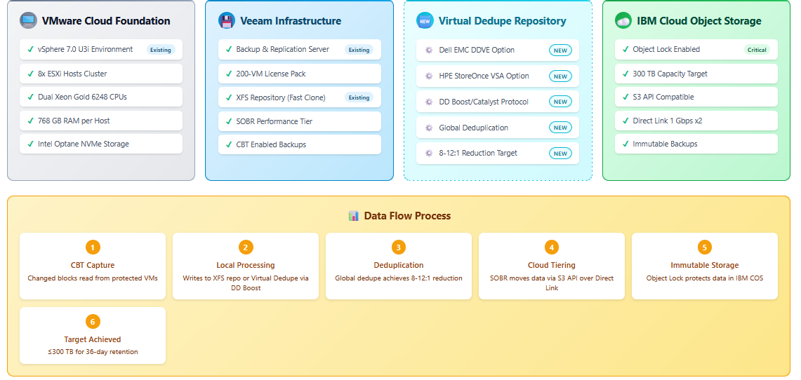
Immutability: 36-day retention
Notes:
Implementation view
Separate what exists (VCF + Veeam) from what was added (one virtual dedupe repo VM).
New component options: DDVE or StoreOnce VSA using DD Boost/Catalyst for global dedupe; target 8–12:1.
IBM COS: Object Lock ON, 300 TB cap, Direct Link ×2.
Data flow:
CBT capture →
Write to XFS or Virtual Dedupe →
Global dedupe →
SOBR offload to COS →
Immutability enforced →
Target met (≤300 TB at 36 days).
Purpose: a clear checklist for Consulting to implement—software-only, no new hardware.

